Slide 1









University of Diyala / College of Eng. Civil Engineering Department.
Class: 1st year /Mathematics I
Homework
/ Find the distance between given points:
1 7,10 , 1,2 2 0,4 , -4,0 3 t,4 , t,0 4 -3,-5 , -7,-8
5 ⁻¹ , ⁻³ , -3, ⁻⁵ 6 a,b+1 , a+1,b
2 2 2
Ans. 1 10 2 4 2 3 4 4 5 5 29/2 6 2
/ Use distance formula to show that the given points are represent the vertices of right-angled triangle, then find the area of triangle.
1 A -1,-2 , B 3,-2 ,and C -1,-7
2 A 0,0 , B -3,3 ,and C 2,2
3 A -2,-5 , B 9,1/2 ,and C 4,21/2
Ans. 10 sq.unit
Ans. 6 sq.unit
Ans. 275/4 sq.unit
/Show that the points A -2,-3 , B 3,-1 ,C 1,4 ,and D -4,2 are
the vertices of a square. Ans. 29
/ If A -5,1 , B -6,5 ,and C -2,4 , determine whether triangle ABC is isosceles Ans. AB=BC= 17
/Find the value of t so that the distance between the points
-2,3 ,and t,t is 5 unit. Ans. t=-2,3
/ If the point P x,y belongs to line passing through P₁ -3,5
and P₂ -1,2 satisfy PP₁ =4 P₁P₂ . Fine the coordinate P .
Ans. 5,-7 , 11,-16
/If the distance between the points 3,y and 8,7 is 13 find y.
Ans. y=19,-5
1

Slide 2











University of Diyala / College of Eng. Civil Engineering Department.
Class: 1st year /Mathematics I
/ Show that quadrilateral ABCD is a parallelogram,A -5,-2 , B 1,-1 , C 4,4 and D -2,3 . Ans. : m_{AB}=m_{CD}=1/6, m_{BC}=m_{AD}=5/3
/ Determine the equation of line passing through -4,3 and
perpendiculars to y=3x-5
/ Find the value of k that make the slope of parallel to the slope of c 5,-2 ,and D 1,4 .
/Find the value of h that make the slope of
Ans. x+3y-5=0
points A k,3 ,B -2,1
Ans. k=-10/3
points A(h,3),B(-2,1)
perpendiculars the slope of c 5,-2 ,and D 1,4 . Ans. h=1
/Find the coordinates of a point equidistance from (1,-6),(5,-6) and (6,-1). Ans. :(3,-3)
/The line segment connecting (x,6) and (9,y) is bisected by the point (7,3). Find the values of x and y. Ans. x=5,y=0
/ If (-2,-4) is the midpoint of (6,-7) and (x,y). Find the values of x and y. Ans. x=-10,y=-1
/What is the length of the line with a slope of 4/3 from a point (6,4)to the y- axis. Ans. 10 unit
/Find the equation of line passing through the origin and with a slope of 6 . Ans.y-6x=0
/Determine B such that 3x+2y-7=0 perpendicular to 2x-By+2=0
Ans. B=3
/A line through -5,2 and 1,-4 is perpendicular to the line through x,-7 and 8,7 . Find x . Ans. x=-6
2

Slide 3


University of Diyala / College of Eng. Civil Engineering Department.
Class: 1st year /Mathematics I
/Show that the three points A (2, 4), B (4, 6) and C (6, 8) are collinear. Ans. m_{AB}=m_{BC}=m_{AC} =1
/ Find the area of triangle which the line 2x-3y+6=0 forms with the coordinate axis Ans. 3 square unit
3

Slide 4

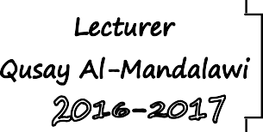







University of Diyala / College of Eng. Civil Engineering Department.
Class: 1st year /Mathematics I
Circle is a locus of points that which moves so that it is equidistance
y
from a fixed point called center.
Standard formula of circle
If r>0 , and C=(h,k) the equation of circle is
r
(h,k)
k
(x-h)² + (y-k)² = r²
O
x
Where r is the radius of the circle,
and h,k are the coordinates of its center.
Basic formula of circle
when r>0 , and C=(0,0) the equation of circle become
h
y
r
O
x
y
x
x² + y² = r²
 /Determine the center C(h,k) and radius r .
(x-1)² + (y+1)² = 9
2 2
/with comparing with standard formula (x-h) + (y-k) = r²
h=1 , k=-1 ⇒= C1,-1 , r² = 9 ⇒=3r
 /Determine the equation of circle with radius 3 and center C(-2,3) .
2 2 2
/ (x-h) + (y-k) = r² ⇒(x+2)² + (y-3) =9
 /Determine the center C(h,k) and radius r of circle equation.
x² + y² + 2x + 8y -8 =0
/ x² +2x +y² +8y =8
2 2 2 2
x² +2x+ ² +y² +8y+ ⁸ =8+ ² + ⁸
2 2 2 2
4

Slide 5



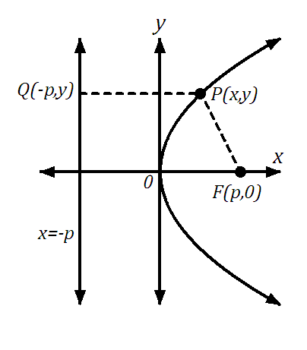
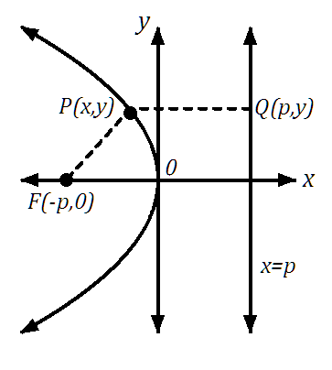
University of Diyala / College of Eng. Civil Engineering Department.
Class: 1st year /Mathematics I
x² +2x+1+y² +8y+16=8+1+16
x+1 ² + y+4 ² =25 With comparing with standard formula
h=-1 , k=-4 ⇒ C= -1,-4 , r² =25 ⇒ ⇒=5r
 /Determine the radius of a circle have center at and containing the point (-2,2).
C(1,6)
/ C 1,6 h=1, k=6 , the point -2,2 ⇒x=-2 ,y=2 r=?
x-h ² + y-k ² = r²
-2-1 ² + 2-6 ² = r²
-3 ² + -4 ² = r²
9 + 16 = r²⇒⇒ r² =25⇒⇒ r=5
Parabola is a locus of a points that which moves so that it is always
equidistance to a fixed point called 𝐟𝐨𝐜𝐮𝐬 and t a fixed straight line called directrix .
Equations of parabola
y²=4px
y²=-4px
5

Slide 6
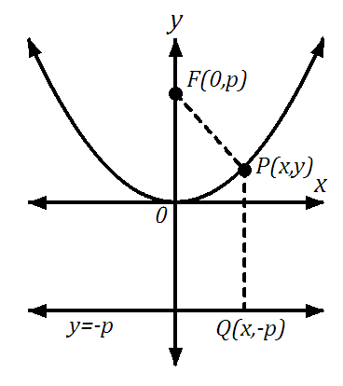
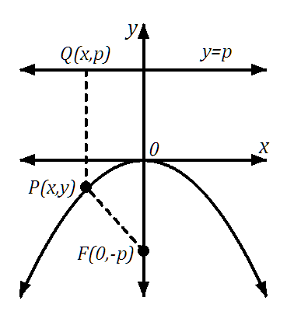






University of Diyala / College of Eng. Civil Engineering Department.
Class: 1st year /Mathematics I
x²=4py
x² =-4py
 / Determine the coordinates of focus and equation of directrix for the parabola y² =-8x
/ with comparing with y²=-4px ⇒ 4p=8 ⇒ p=2 F (-P, 0)= -2, 0
Directrix D: x=2
 / Determine the coordinates of focus and equation of directrix for the parabola x²=-16y
/ With comparing with x²=-4py ⇒ ⇒4p =16⇒⇒ p=4 F(0,-P)= 0,-4
Directrix D: y=4
The vertex is h,k
 x- axis
Open to the right
y-k ² =4p x-h
 y- axis
Open upward
x-h ² =4p y-k
Open to the left
y-k ² =-4p x-h
Open downward
x-h ² =-4p y-k
6

Slide 7






University of Diyala / College of Eng. Civil Engineering Department.
Class: 1st year /Mathematics I
 / Determine the coordinates of vertex, focus, and equation of directrix for the parabola y+1 ²=-12 x-2
/ with comparing with y-k =-4p x-h
2
h=2 ,k=-1
4p = 12 ⇒ ⇒=3p
Directrix
⇒ vertice hV,k = 2,-1
⇒ focus(-Fp+h,k)= -3+2,1 = -1,1 D: x = p +h = 3+2⇒= x5
 / Determine the coordinates of vertex, focus, and equation of directrix for the parabola x²+4x-10y+34=0
/
₄ 2 ₄ 2
2 2
x +4x = 10y-34 ⇒ x +4x+ =10y-34+ ₂
2
x² +4x+4 = 10y-30 ⇒ x+2 ² =10 y-3
2
With comparing with x-h = 4p y-k
h=-2 , k=3 ⇒ vertxe hV,k = -2,3
4p=10 ⇒ ⇒=p⁵ , ⇒ focu(shF,p+k)= -2, ⁵ +3 = -2, ¹¹
2 2 2
Directrix D: y=-p+k =- ⁵ +3⇒= ¹y
 / Determine the coordinates of vertex for the parabola 3y=4x²+4x+5
2 2
/ 3y=4x² +4x +5⇒ ⇒ 4x² +4x =3y-5 ÷4
x² +x = ³ y- ⁵ ⇒x² +x + ¹ ² = ³ y - ⁵ + ¹ ²
4 4
2 4 4 2
⇒ x + ₂ = ₄ y-1
2
1 3 5 1
₁ 2
3
x + x + ₄ = ₄ y - ₄ + ₄
₁ 2
3 4
x+ ₂ = ₄ y- ₃
2
With comparing with x-h = 4p y-k
h=- ¹ , k= ⁴ ⇒ vertxe V h,k = - ¹ , ⁴ 2 3 2 3
7

